Slide 1
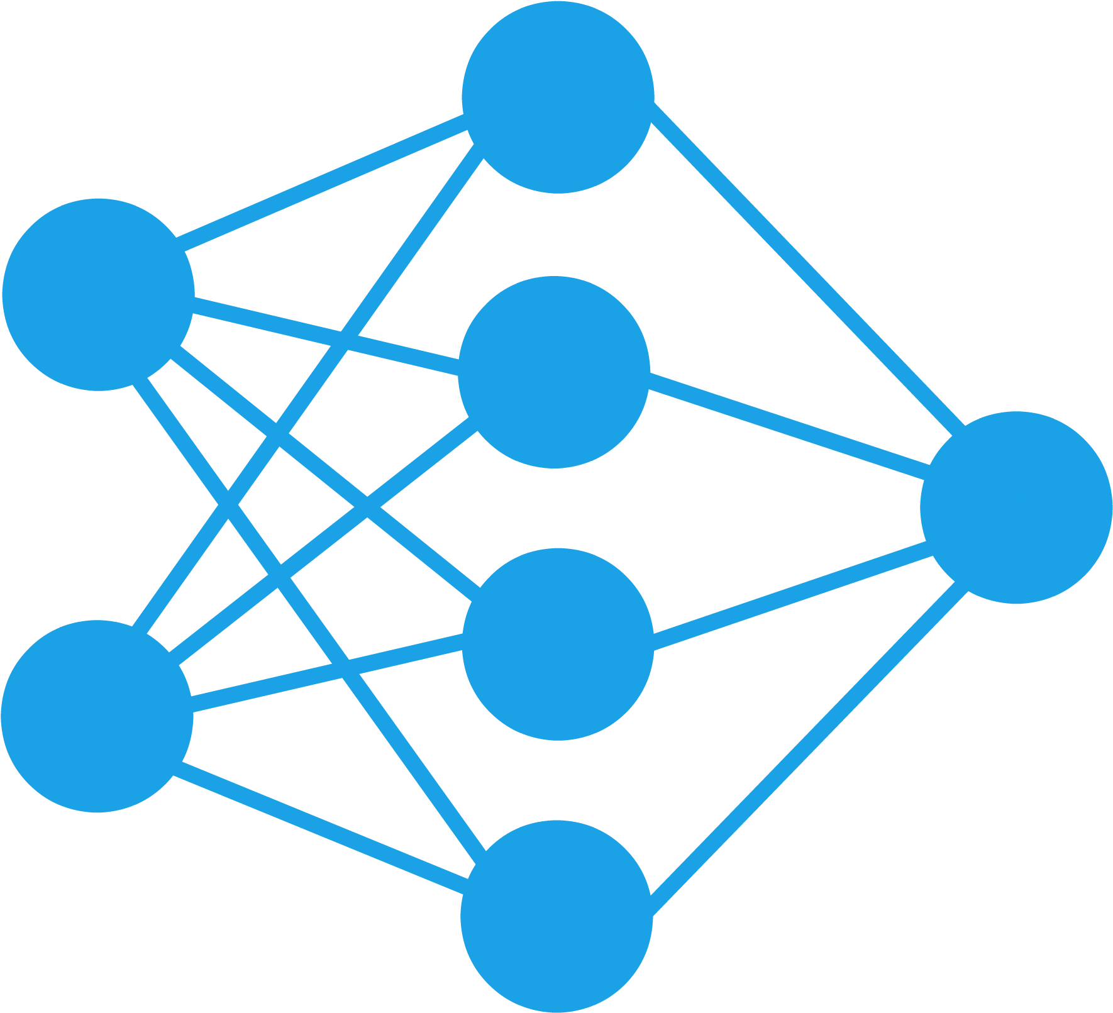
MGMT298D
Science and Strategy of AI
Week 4
Neural Networks
Auyon Siddiq UCLA Anderson School of Management

Slide 2

Recap
WEEKS 1–3
Machine
Learning
Goal: Understand how to deploy ML models to make predictions or decisions based on rich data
Prediction using tabular data (linear regression + tree-models / XGBoost)
Reinforcement learning for dynamic decision-making (bandits, Q-learning)

Slide 3
Preview
WEEKS 4–7
Deep
Learning
Goal: Build intuition on how complex AI models are created and how they extract “meaning” from numeric, text, and image data
deep learning
=
neural networks
=
foundation of all modern AI

Slide 4
Brief History of Neural Networks

Slide 5
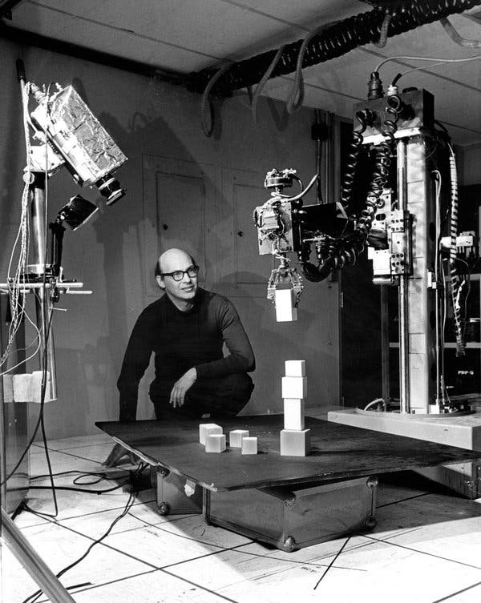
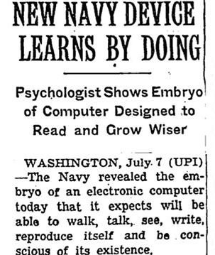
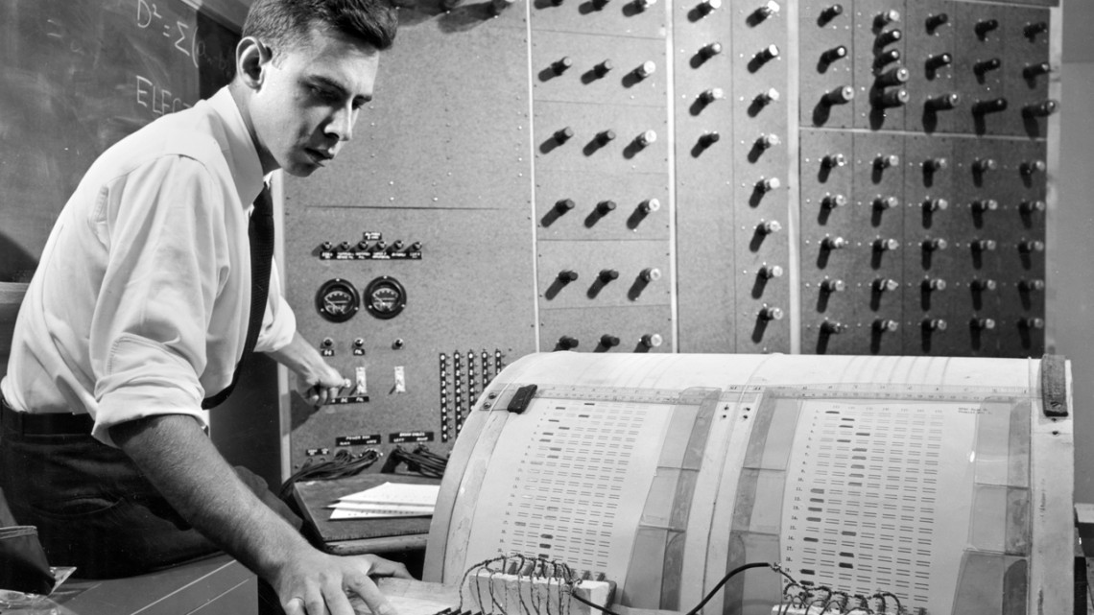
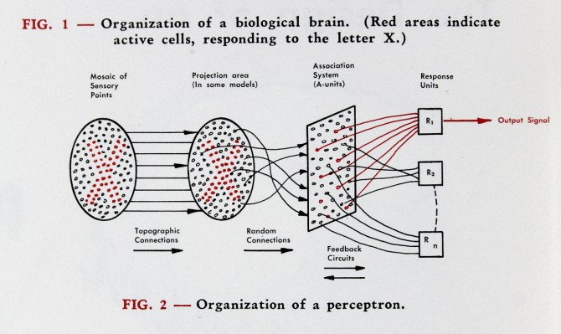
Rosenblatt’s Perceptron (1958)
Frank Rosenblatt
“connectionist” school of thought on AI
Marvin Minsky “symbolic” AI
New York Times, 1958

Slide 6
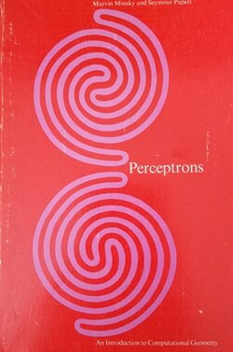
First AI Winter (1970s)
1969: Marvin Minsky writes a book (“Perceptrons”) that theoretically shows Rosenblatt’s single layer perceptron fails at certain basic classification tasks. Technically correct, but casts a shadow over all neural net research
1969: Concurrently, Congress removes DARPA’s ability to fund basic scientific research, including AI
1971: Rosenblatt dies at age 43, connectionism loses most vocal advocate
1971-1980s: Neural network research goes out of fashion. Focus shifts to symbolic AI instead (“If-then”) → Minsky’s preferred school of thought
Neural networks remain academically interesting, but lacked an algorithm to train them

Slide 7
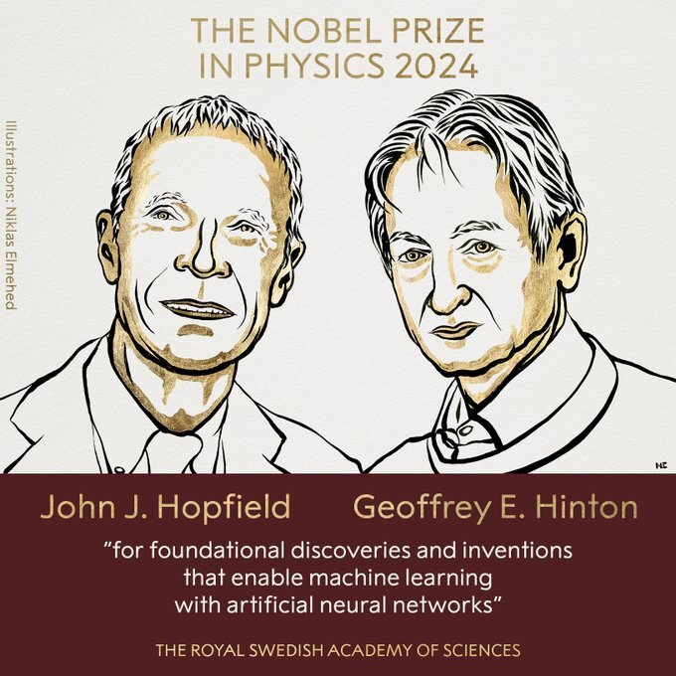
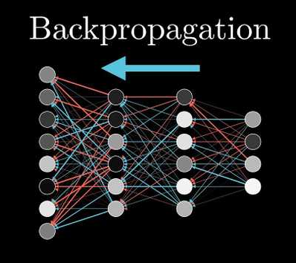
Backpropagation (1986)
1980s: AI funding boom based on symbolic methods and specialized symbolic AI hardware
1986: Breakthrough: Geoffrey Hinton and co-authors propose an algorithm for training multi-layer neural networks called “backpropagation”, still used now
the whole paper
Backprop made training NNs possible, but compute / data were still lacking, backprop unstable for larger networks

Slide 8


Second AI Winter (1987 – 2000s)
1987: Personal computers emerge (Apple/IBM), funding for symbolic AI and associated specialized hardware crashes
1990s: AI hype dies down, internet takes off (generating the data eventually used by LLMs)
2000s: Focus shifts to classical machine learning (random forests and support vector machines). Neural networks and “artificial intelligence” is toxic for research funding.
The Big 3 -- Hinton, Bengio and LeCunn -- quietly push NNs for 20 years despite unpopularity
Hinton: “They basically refused to allow people to publish neural network stuff in their journals.”

Slide 9

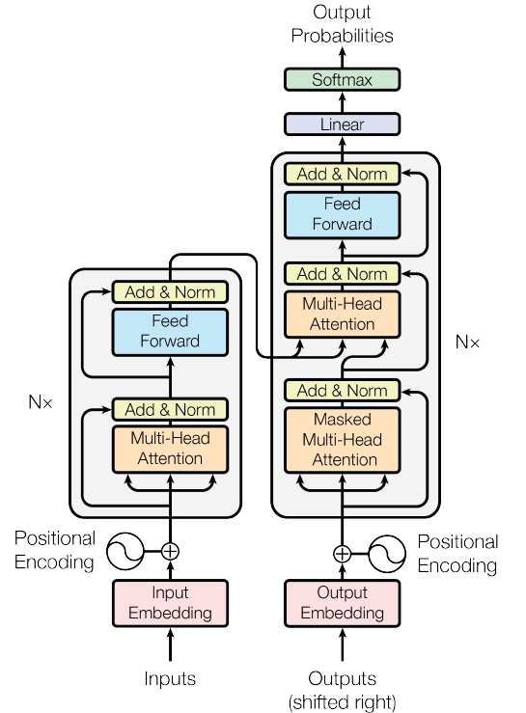
Deep Learning Revolution (2012-present)
2006: Fei-Fei Li (Stanford) assembles ImageNet, now a repository of 14 million labeled images for neural network training. Creates a common research benchmark for evaluating deep learning models and algorithms, brings the idea of massive data to NNs
2012: Alex Krizhevsky and Ilya Sutskever -- two of Hinton’s PhD students at U of Toronto -- build AlexNet which shatters the errors record on ImageNet (26% to 16%). Neural nets dominate vision, speech, and language. Everyone is now obsessed with neural networks.
2017: “Attention Is All You Need” paper by Google proposes transformers, a specific NN architecture, which gives birth to LLMs.
2018: Turing Award. Hinton, LeCun, Bengio share computing’s highest honor for work the field ignored for decades.
2022: OpenAI releases ChatGPT.

Slide 10
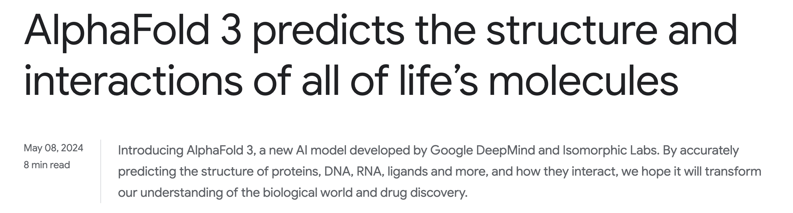
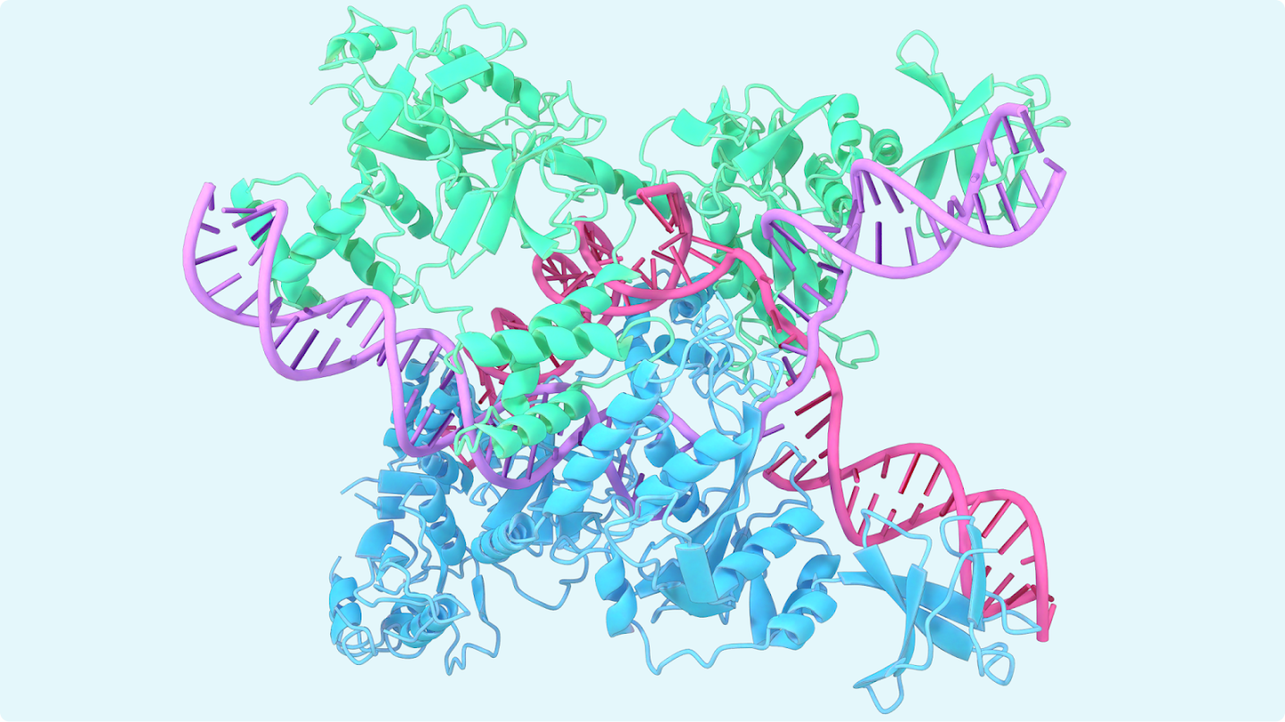
Prediction Problem: Predict a protein’s 3D structure from its amino acid sequence, a long-standing challenge in biology.
AlphaFold 2 (2020): DeepMind’s neural network cracks the problem, predicting structures with near-experimental accuracy.
Impact: Accelerating drug discovery, enzyme design, disease research.
Recognition. Hassabis and Jumper share the 2024 Nobel Prize in Chemistry, first Nobel awarded for a deep learning system. Same year as Hinton and Hopfield Nobel Prize in Physics for deep learning.

Slide 11
Today’s Class
We will cover the fundamentals of neural networks and how to train them Everything today’s class is about how modern AI is built (e.g., ChatGPT, Claude)
Most advanced math in deep learning: addition, multiplication, exponents, and slope of a curve (“derivative”)
Understanding how neural networks work will help shed light on questions like: - Why does training frontier AI models cost hundreds of millions of dollars? - Why is Amazon building enormous data centers? - Why is NVIDIA worth 4.8T?

Slide 12
Neural Networks
Regression and trees work well on tabular data with hand-picked features (e.g., month, color, product category)
Images, audio, text → not as obvious how to represent numerically
Traditional approach: hand-engineered features (word counts, sentence length, etc.). Why doesn’t this work well?
Neural networks: Let the model learn its own features (“representations”) from the raw data

Slide 13
Deep Learning Fundamentals:
The Artificial Neuron

Slide 14
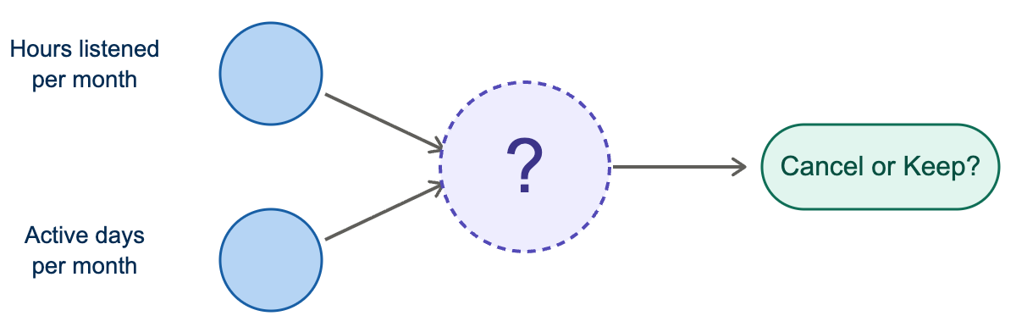
A Simple Example: Customer Churn
Can we predict which users will cancel their music streaming subscription?

Slide 15
Data
User | Hours / Month | Days Active | Y (Keep?)
User A | 15 | 22 | 1
User B | 8 | 6 | 0
User C | 60 | 7 | 1
User D | 12 | 21 | 0
User E | 5 | 2 | 0

Slide 16
The Artificial Neuron
We can model the probability of user keeping subscription as:
Or visually:
Hours per month
Active days

Slide 17
The Artificial Neuron
For example:
Hours per month
0.4
0.1
Active days
0.5
Which is equivalent to:

Slide 18
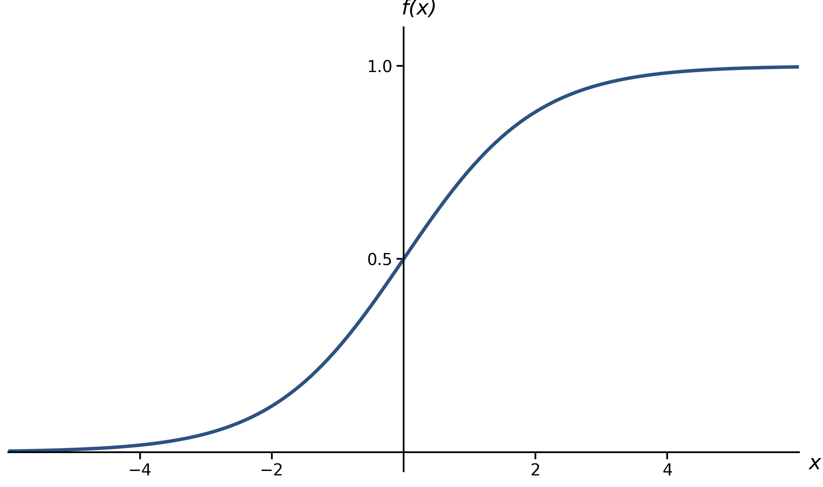
Neuron Output: Sigmoidal Function
Is an example of an activation function
Hours per month
A simpler visualization:
Active days

Slide 19
Loss Function
We need to pick a loss function to measure how bad the model’s predictions are
User | Hours / Month | Days Active | Keep? (Y) | P(Keep) | “Desired” Loss
User A | 15 | 22 | 1 | 0.999 | Very Low
User B | 8 | 6 | 0 | 0.967 | Very High
User C | 60 | 7 | 1 | 0.999 | Very Low
User D | 12 | 21 | 0 | 0.999 | Very High
User E | 5 | 2 | 0 | 0.750 | High

Slide 20
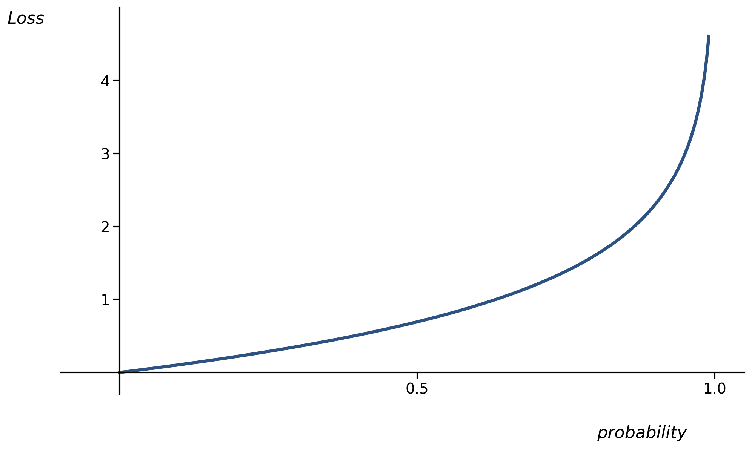
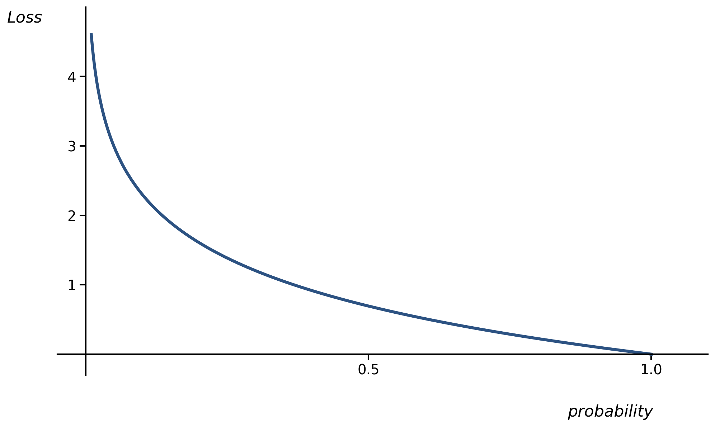
Loss Function
What do we want the loss function to look like?
For y = 0:
For y = 1:
Notes:
Draw example loss function of what we desire on the board

Slide 21
Loss Function
What do we want the loss function to look like?
For y = 0:
For y = 1:
Notes:
Draw example loss function of what we desire on the board

Slide 22
Loss Function
Binary cross entropy (per data point):
User | Hours / Month | Days Active | Keep? | P(Keep) | Desired Loss | BCE Loss
User A | 15 | 22 | 1 | 0.999 | Very Low | 0.001
User B | 8 | 6 | 0 | 0.967 | Very High | 3.411
User C | 60 | 7 | 1 | 0.999 | Very Low | 0.001
User D | 12 | 21 | 0 | 0.999 | Very High | 6.908
User E | 5 | 2 | 0 | 0.750 | High | 0.288
BCE loss measures the “wrongness” of our model for each data point.
Notes:
Break it out for positive and negative cases to “derive” it

Slide 23
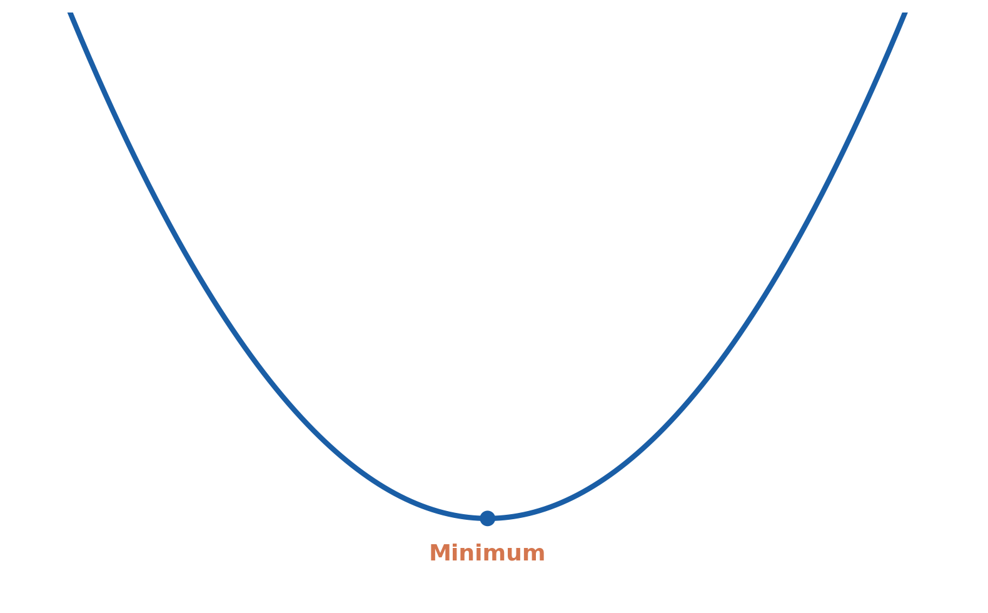
Picking the Best Weights
We want to pick the weights that make the loss function as small as possible → this is an optimization problem
Loss
Weight
Notes:
Cauchy in 1847

Slide 24
Gradient Descent
The gradient tells us the sensitivity of the loss to each weight parameter w in the network
Sign: Does Loss increase or decrease if we increase w? Magnitude: How “quickly” does Loss change as w changes?
at 1 is large and negative
at 2 is small and negative
at 3 is small and positive
at 4 is large and positive
Loss
1
2
3
4
Weight
Notes:
Cauchy in 1847

Slide 25
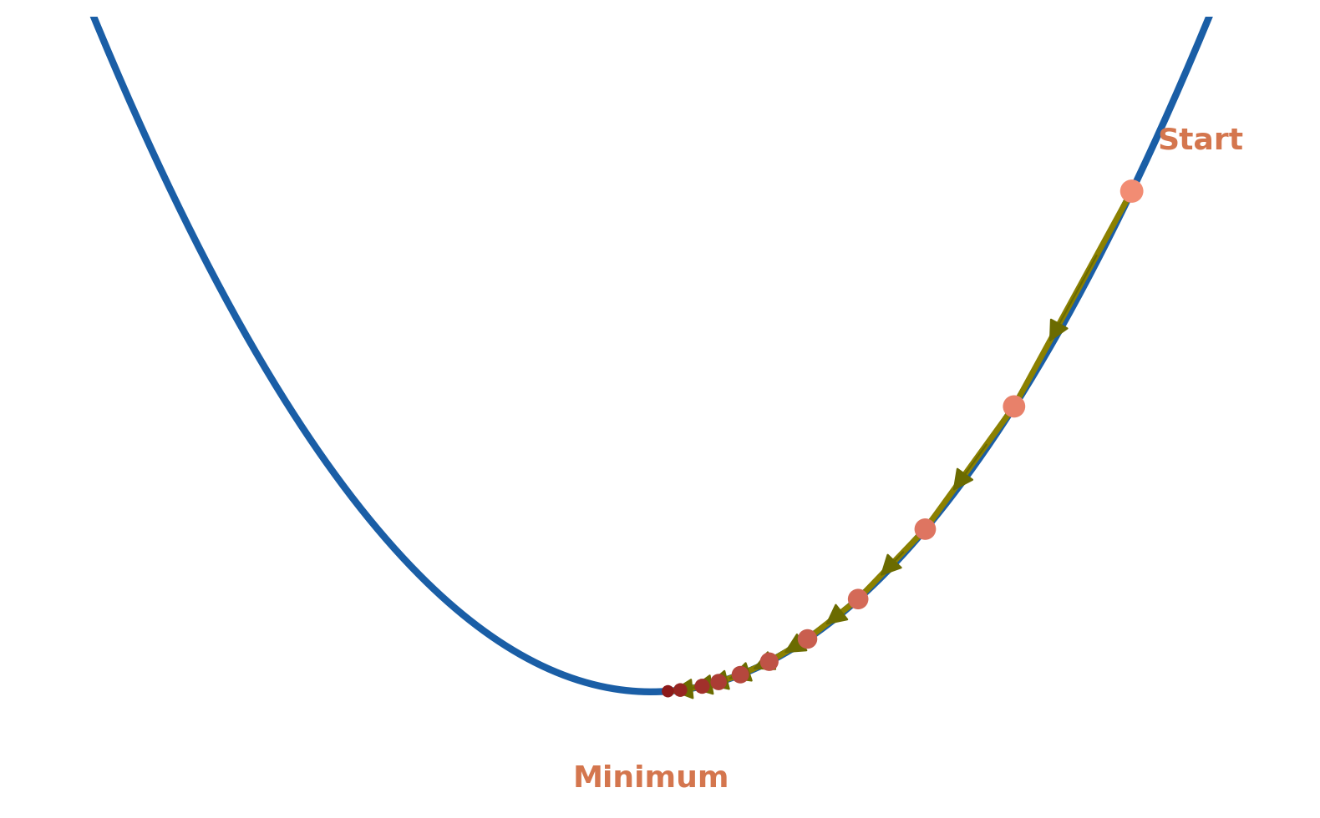
Gradient Descent
Gradient descent is an updating rule for weights to “nudge” them in the direction that decreases the loss function
learning rate
Loss
Repeat many times for all weights in the network
Updating all weights for all data is one epoch
This is model training for neural networks
Weight
Notes:
Cauchy in 1847

Slide 26
Gradient Descent
Gradient descent is an updating rule for weights to “nudge” them in the direction that decreases the loss function
Example:
0.7
0.414
0.4
0.02
Loss
Repeat many times for all weights in the network
Updating all weights for all data is one epoch
This is model training for neural networks
Weight
Notes:
Cauchy in 1847

Slide 27
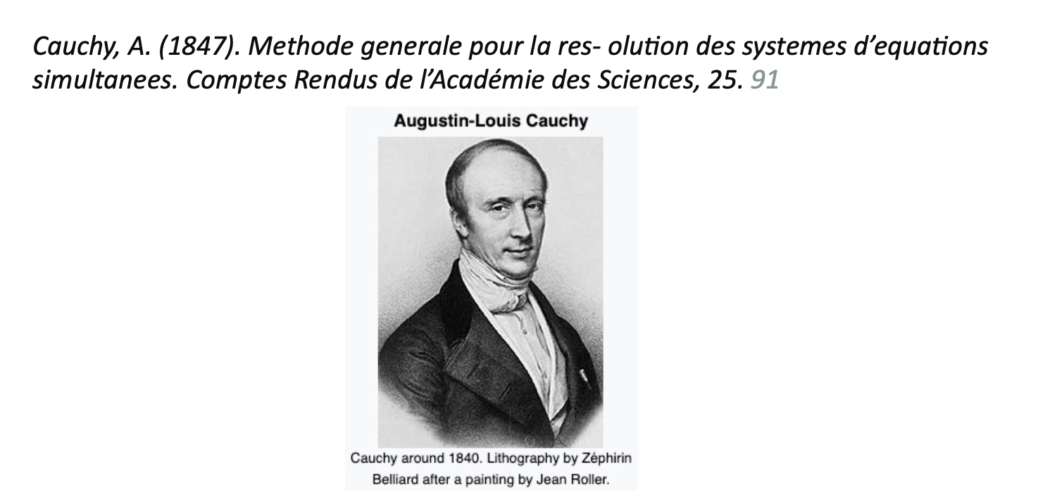
When was gradient descent first discovered?
1847
Notes:
Cauchy in 1847

Slide 28
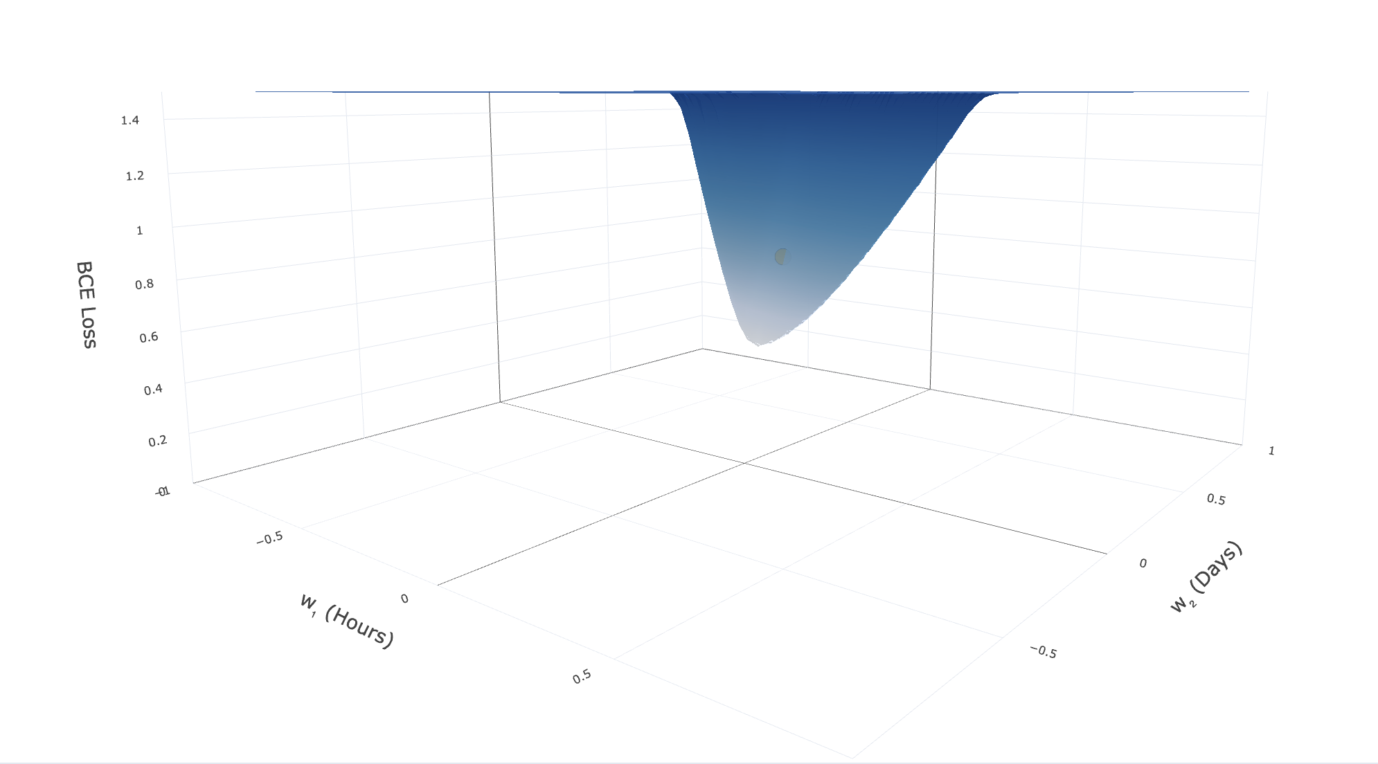
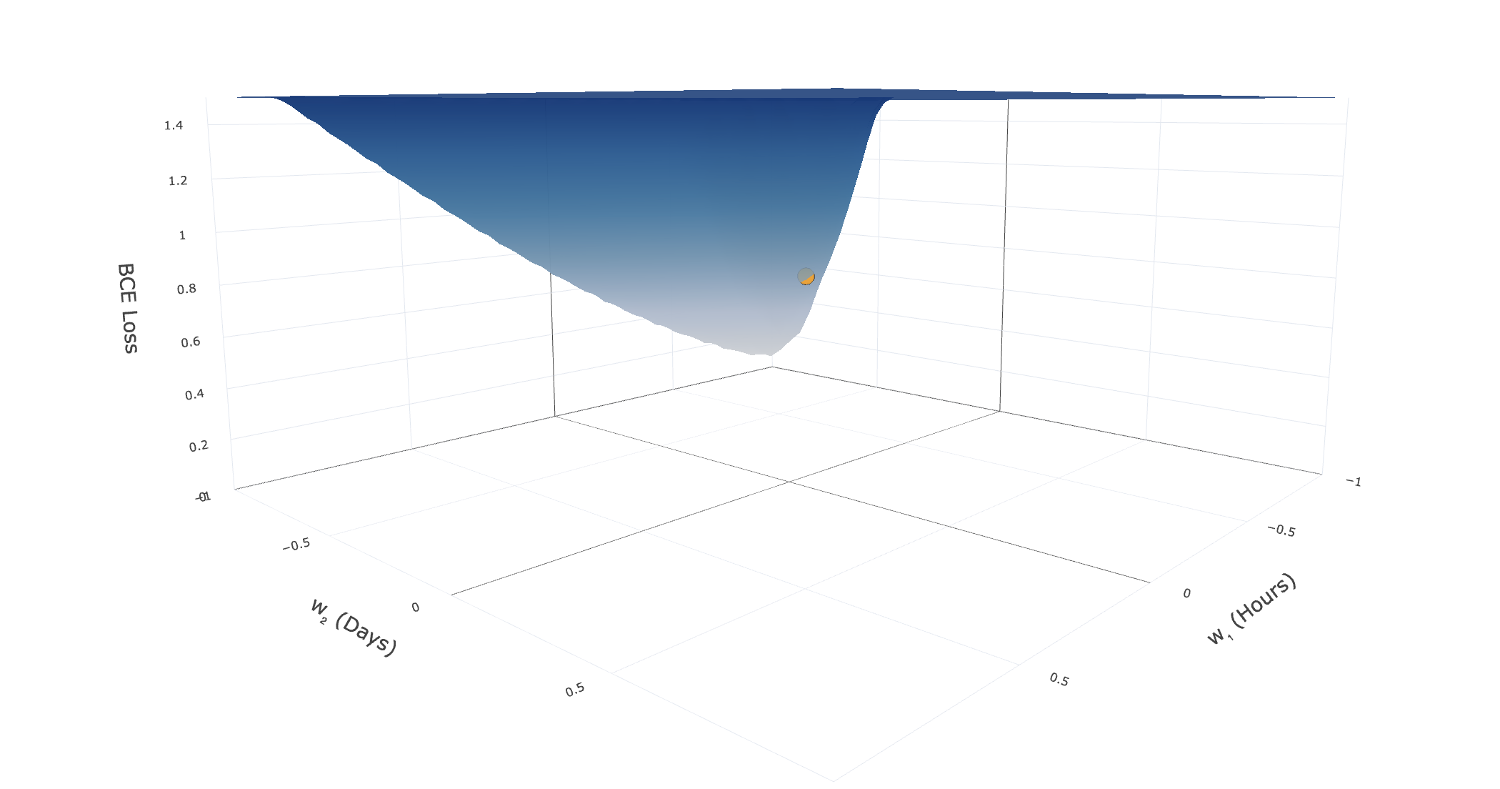
Loss Function Visualized
Notes:
Cauchy in 1847

Slide 29
Gradient Descent Simulation

Slide 30
Hidden Layers

Slide 31
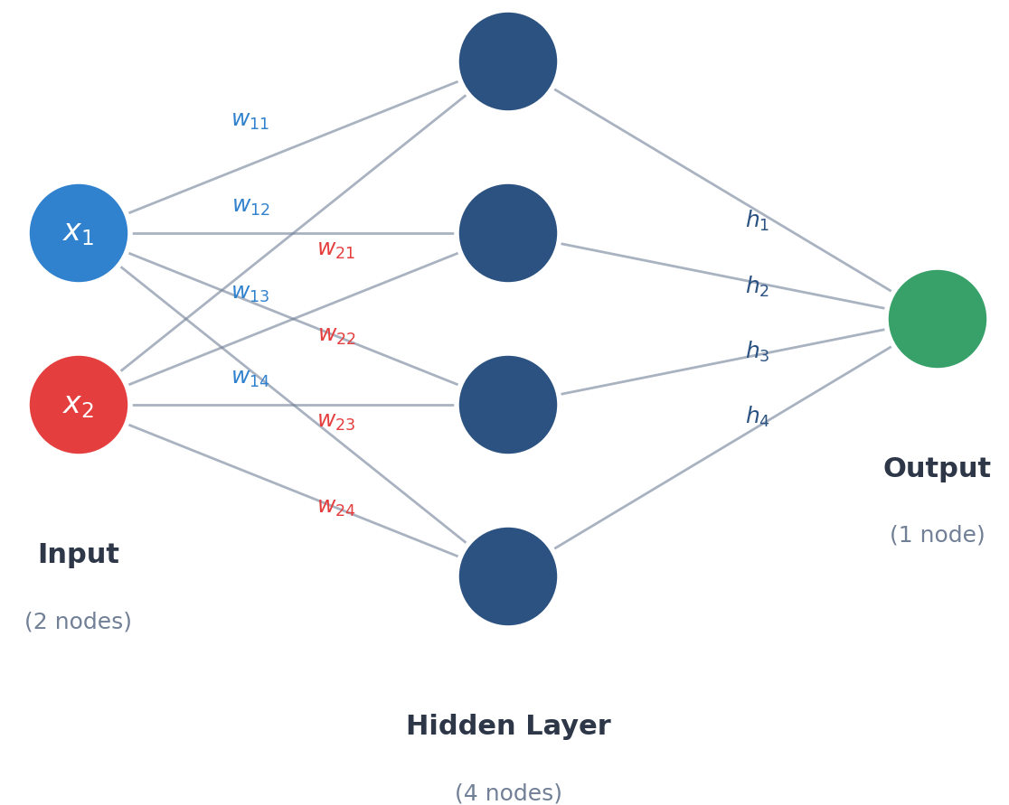
Hidden Layers
A single neuron has limited predictive performance – only one weight per feature
Adding a hidden layer gives the network much more capacity (i.e., weights) to learn
Purpose of hidden layer: learn a representation of the data that makes the final classification easier

Slide 32
Hidden Layers
Each input is multiplied by a weight and added up at each hidden node
Each hidden node's output is multiplied by a new weight and added up at the output node
Also called a dense layer — every node is connected to every node in the previous layer

Slide 33
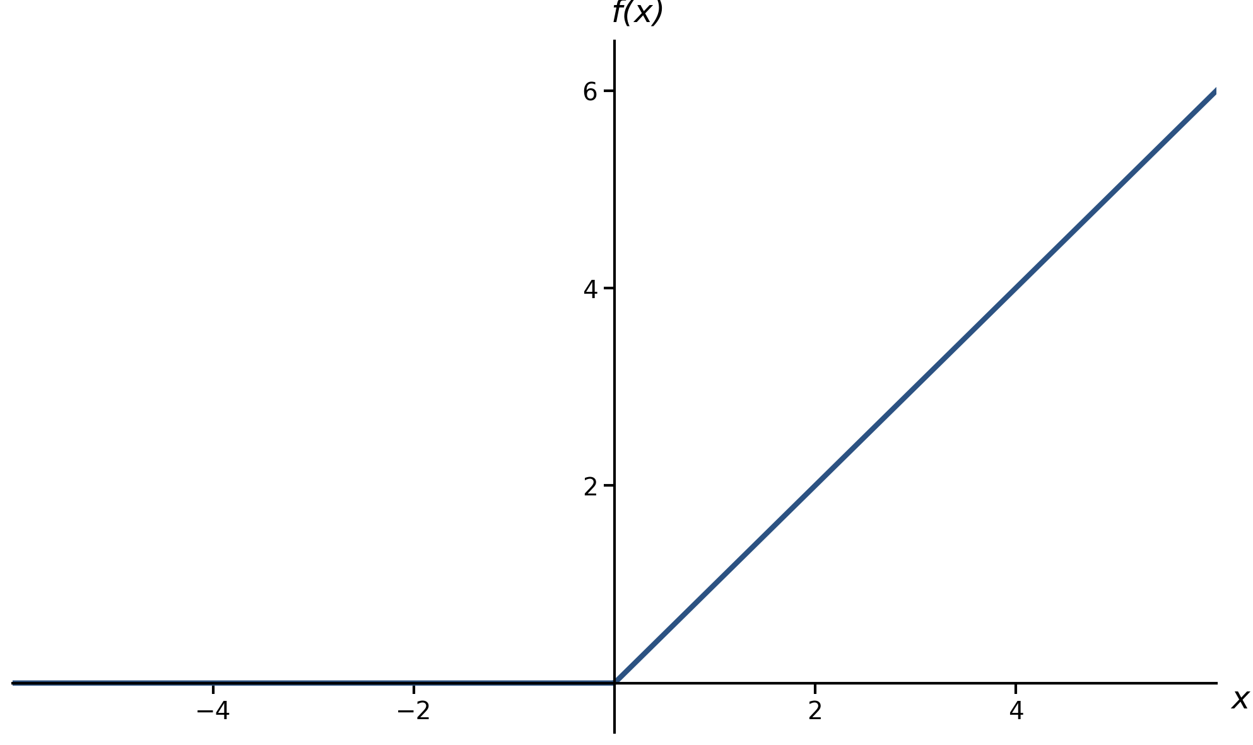
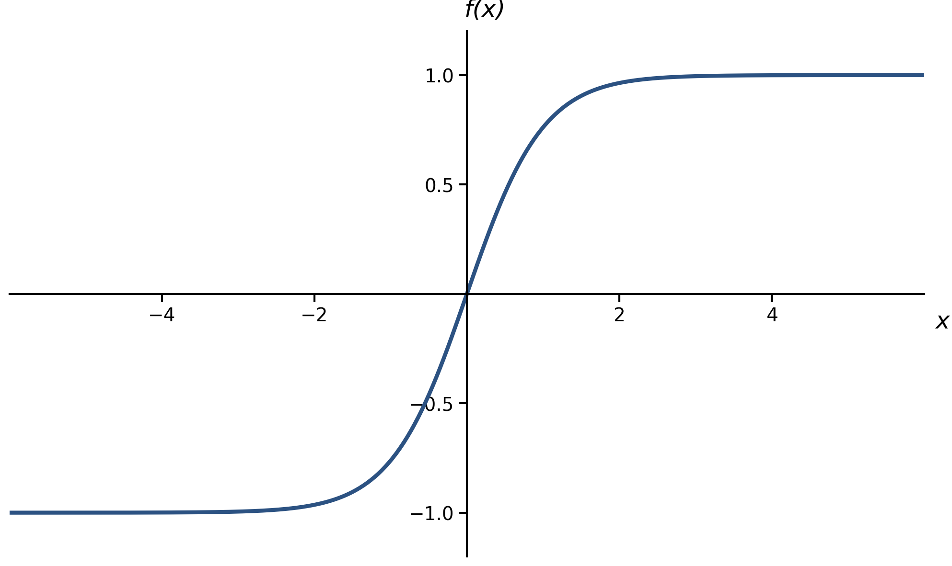
Hidden Layer Activation Functions
ReLU
(Rectified Linear Unit)
Sigmoid
Tanh
Used for hidden layers
Only used at output nodes
More exotic less common

Slide 34
Hidden Layers
Input to final output node:
Output neuron “sees” output of hidden layer nodes instead of raw data (hours listened, active days)

Slide 35
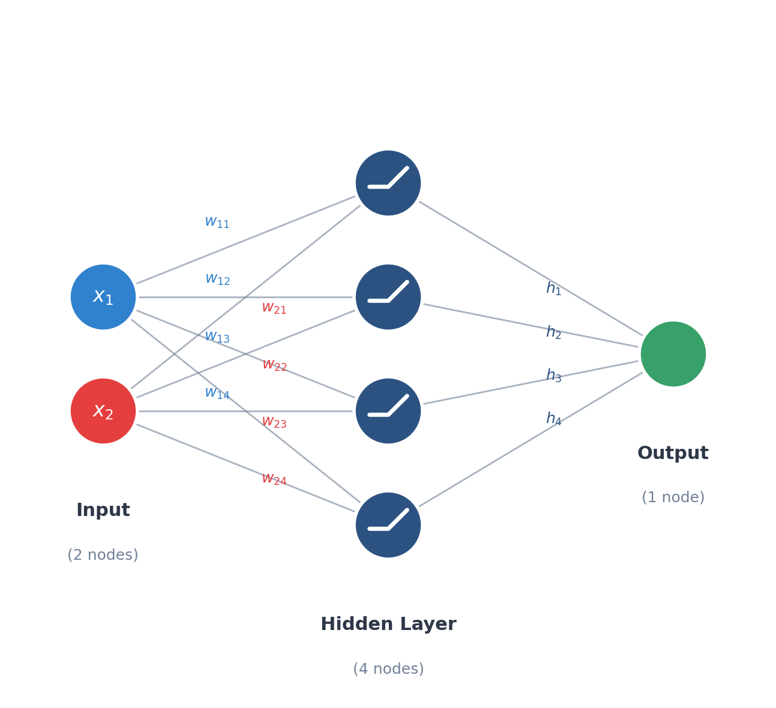
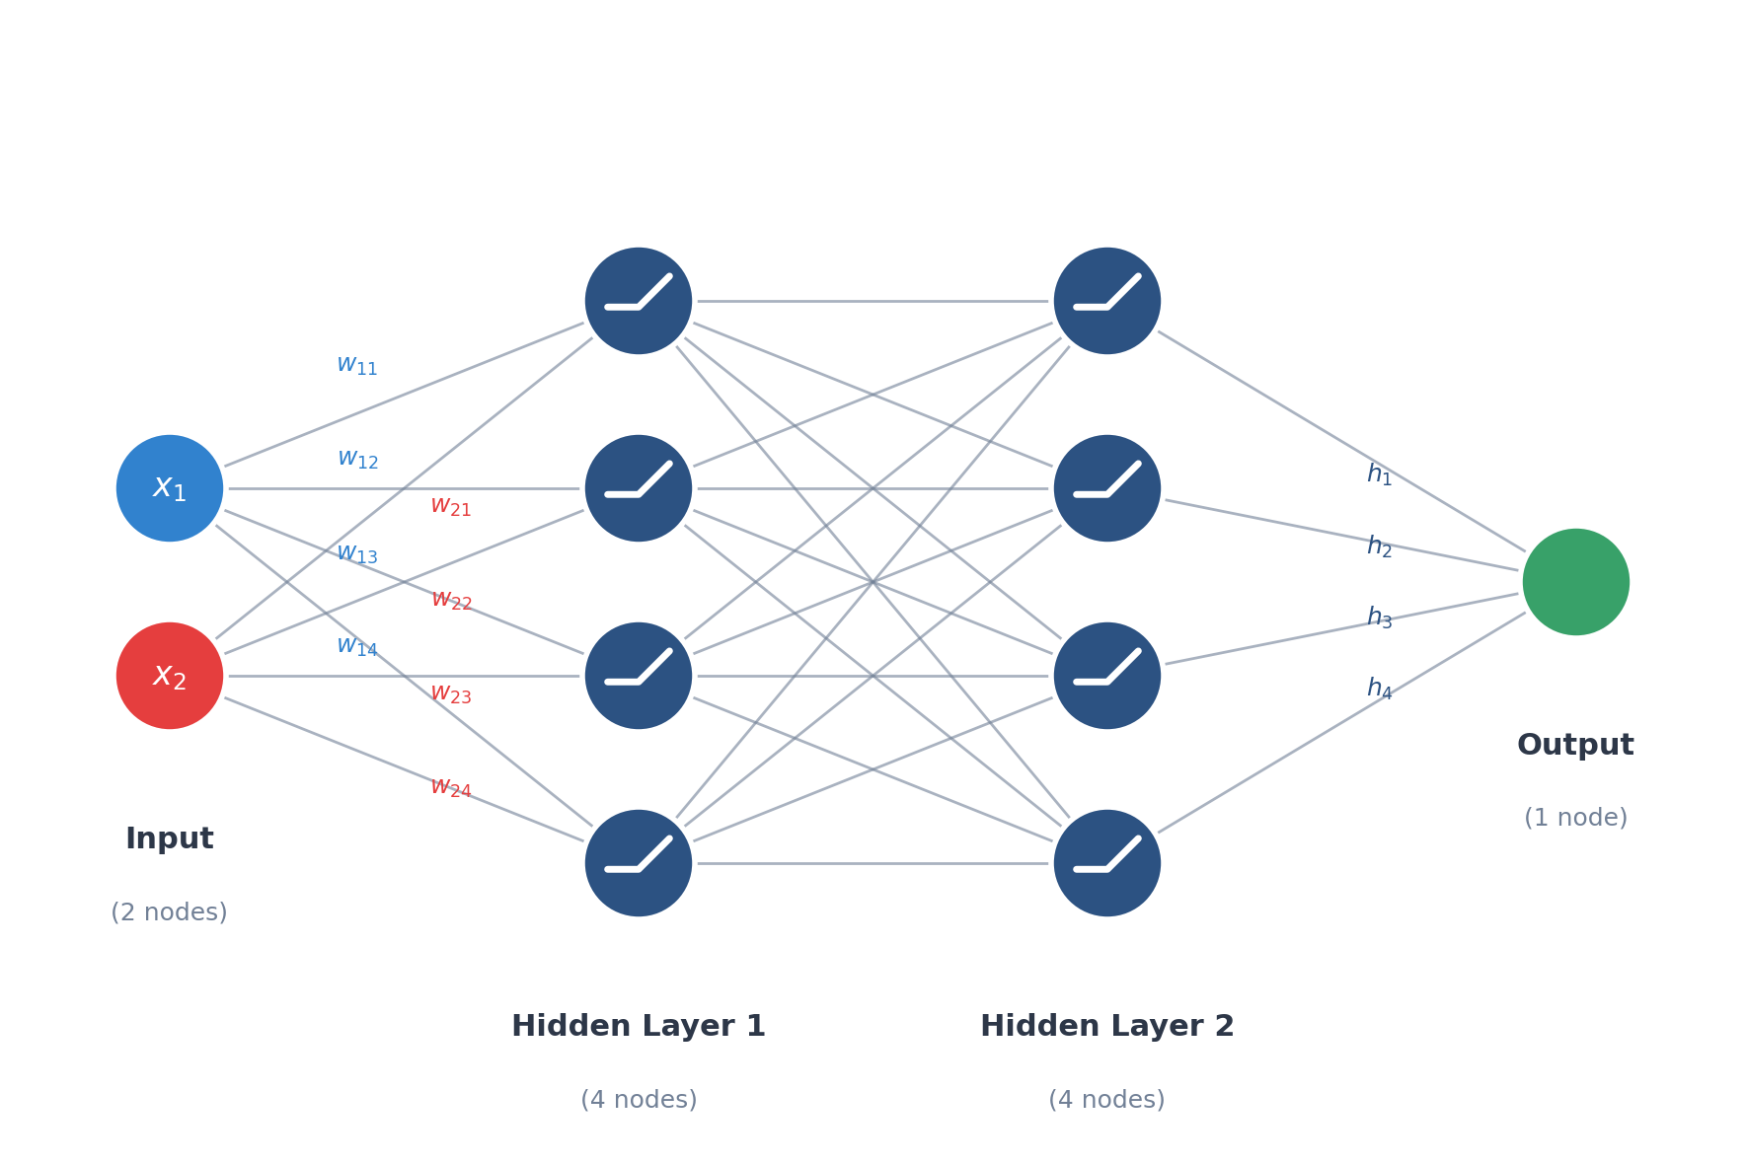
Adding hidden layers gives the network additional capacity to learn
The network’s configuration of nodes is called its architecture
Notes:
What does the output node “see” as input? Just some abstract representation – the raw data has been transformed. As far as the output node is considered, they’re just doing logistic regression!

Slide 36
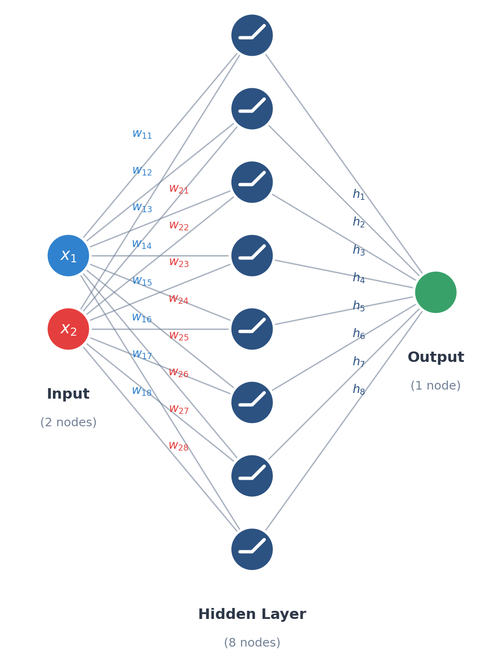
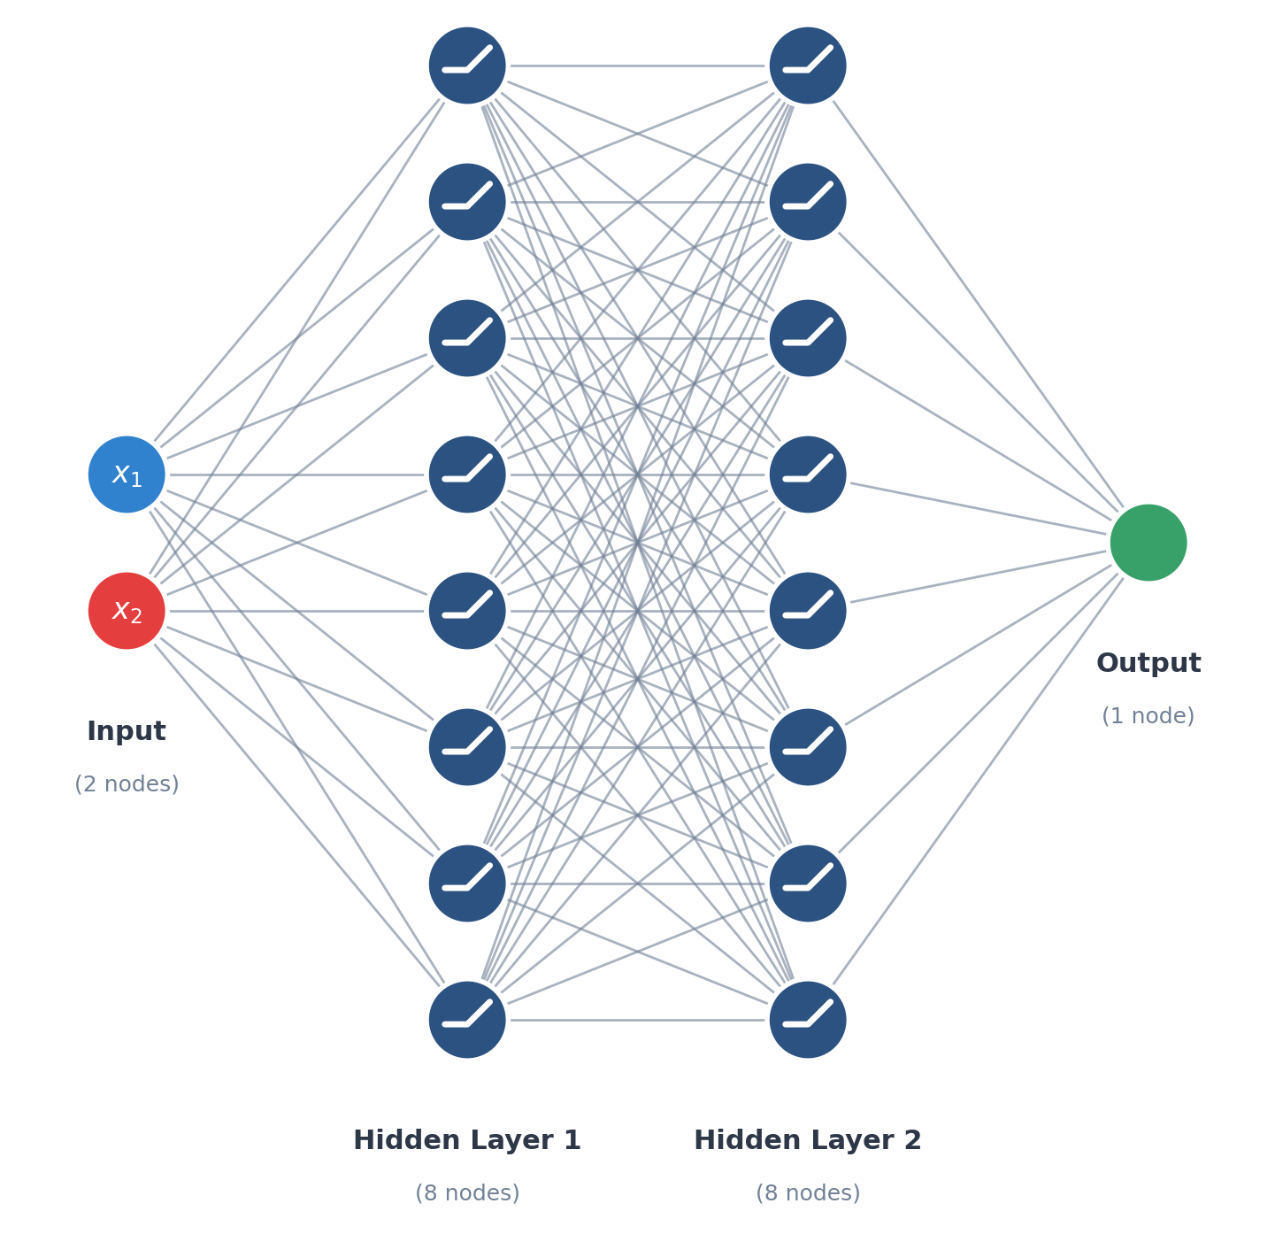
How many weight parameters in the networks above (including biases)?
Notes:
2*8 + 8 + 8*1 + 1 = 33
2*8+8 + 8*8+8+8*1+1 = 105

Slide 37
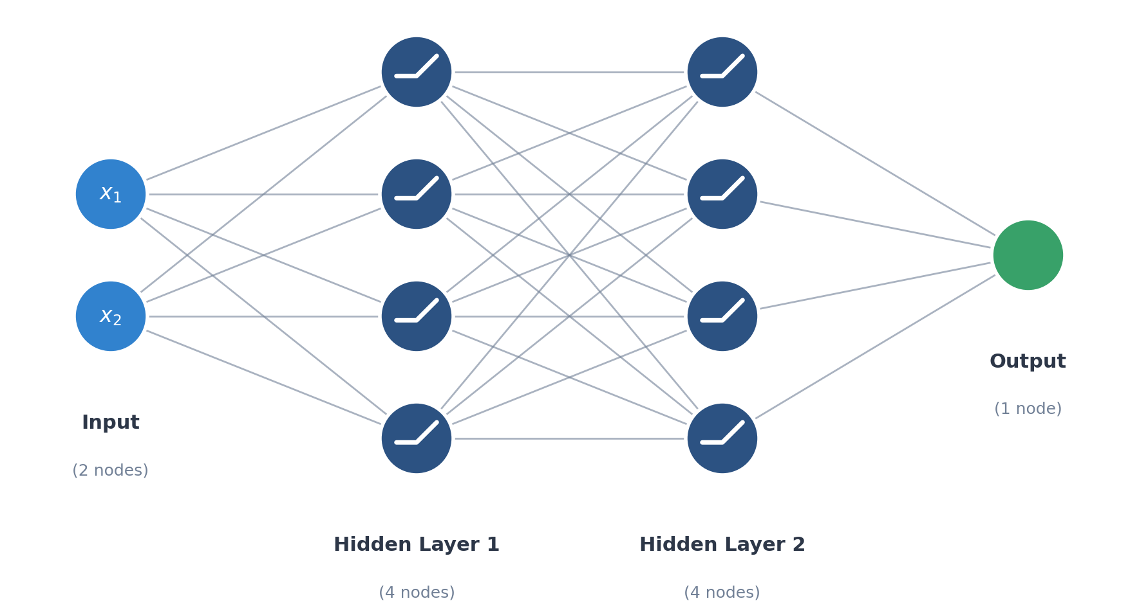
Training Neural Networks: Backpropagation
We still use gradient descent, but need to deal with multiple hidden layers to calculate the gradient of the loss function correctly Backpropagation: Use each layer’s gradient to compute the gradient of the layer before it

Slide 38
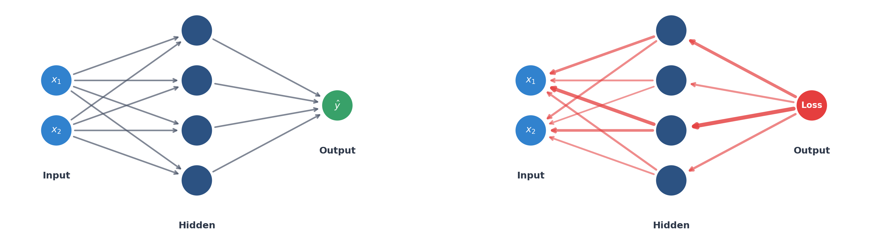
Backpropagation
Repeat three steps: Forward pass: Pass each training data point through the network to compute total loss Backward pass (Backprop): Compute gradient for every weight in the network Update: “Nudge” weights using gradient descent update rule to shrink loss slightly:
Forward pass
Backward pass
Each pass is many multiplication and additions – that’s it

Slide 39
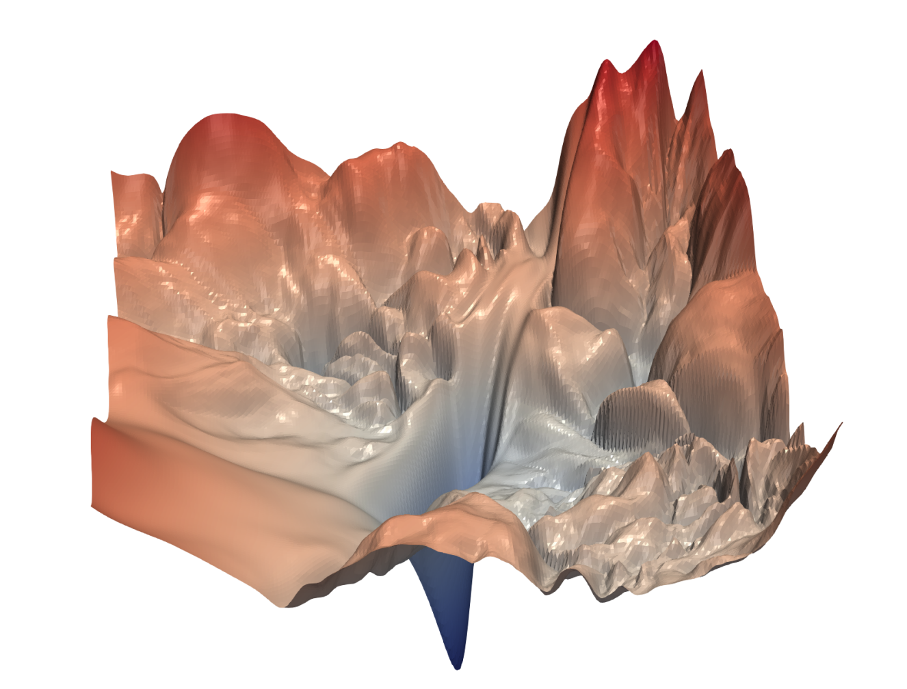
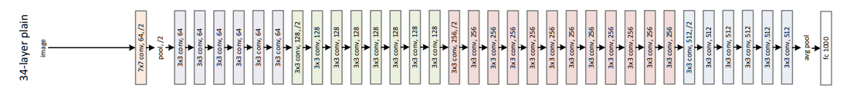
Loss Surface of Neural Networks
Resnet-56
Gradient descent = “rolling ball down a hill”
Loss surface of deep neural networks is often chaotic
→ no guarantee of finding optimal weights

Slide 40
Tensorflow Playground

Slide 41

15-min Break

Slide 42
Deep Neural Networks

Slide 43
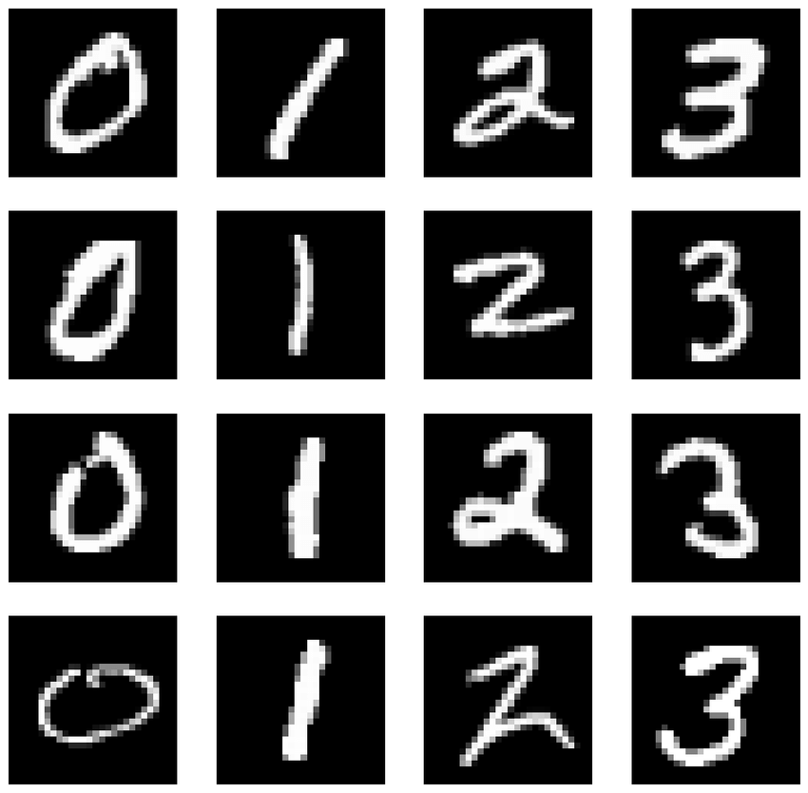
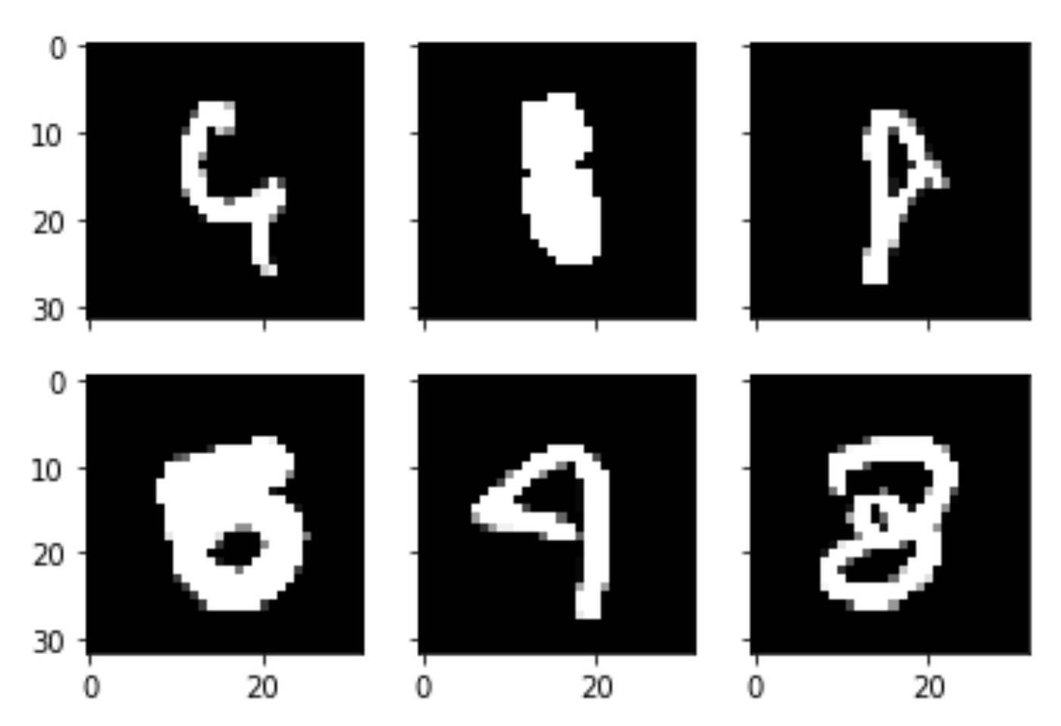
Handwriting Recognition (MNIST)

Slide 44
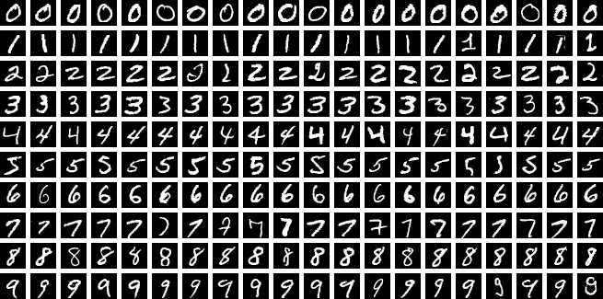
Handwriting Recognition (MNIST)

Slide 45
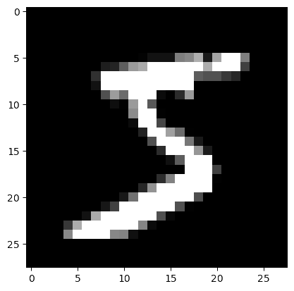
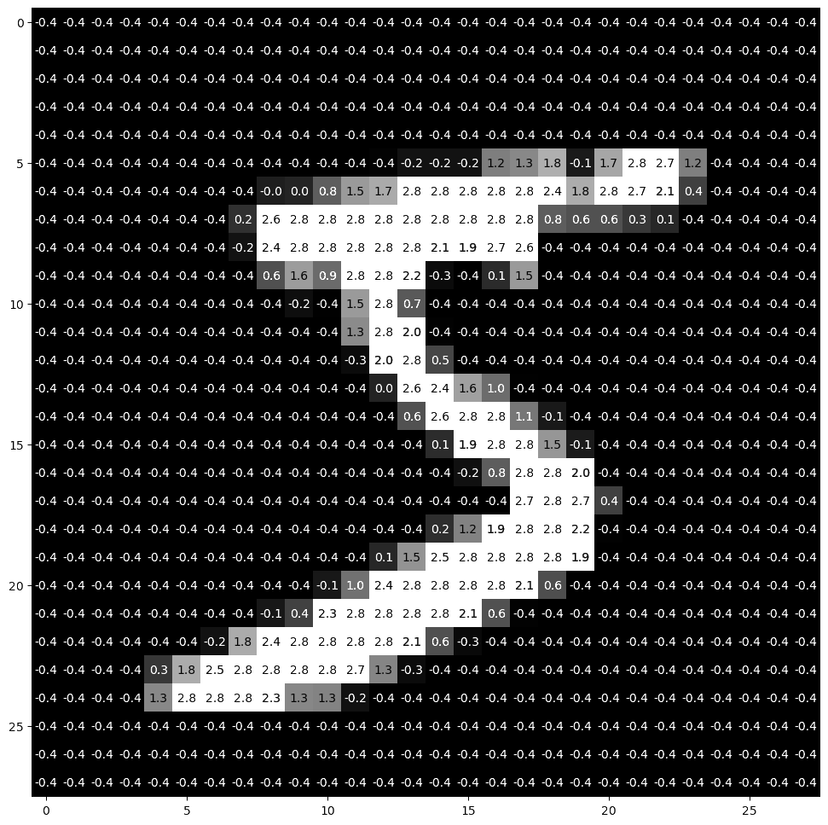
Handwriting Recognition (MNIST)

Slide 46
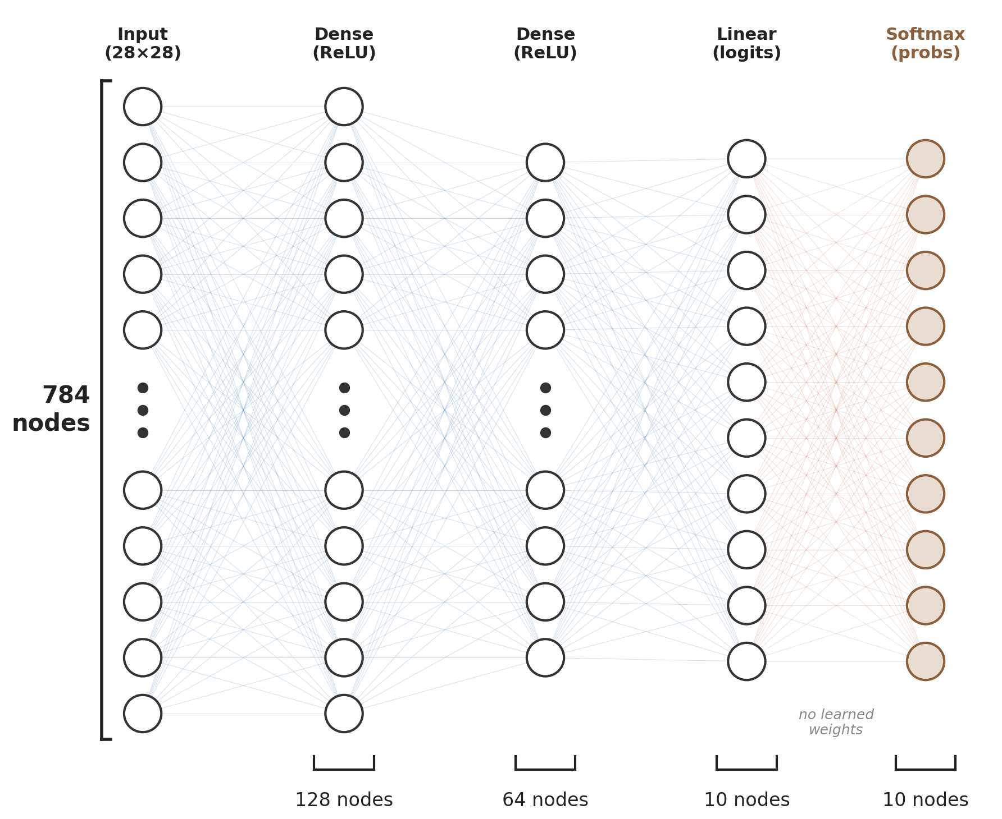
A Network for MNIST
28 pixels
28 pixels
784 → 128: 784 × 128 weights + 128 biases = 100,480
128 → 64: 128 × 64 + 64 = 8,256
64 → 10: 64 × 10 + 10 = 650
Total: 109,386 parameters

Slide 47
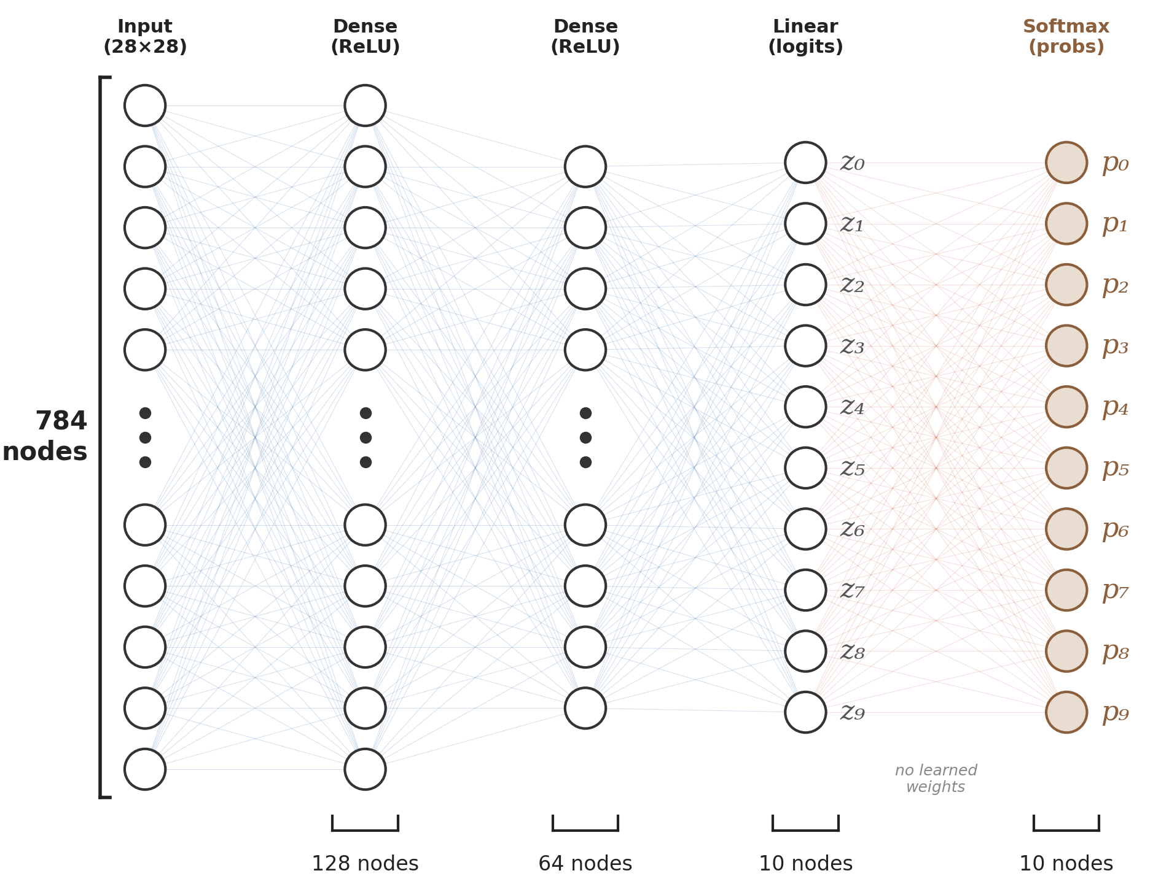
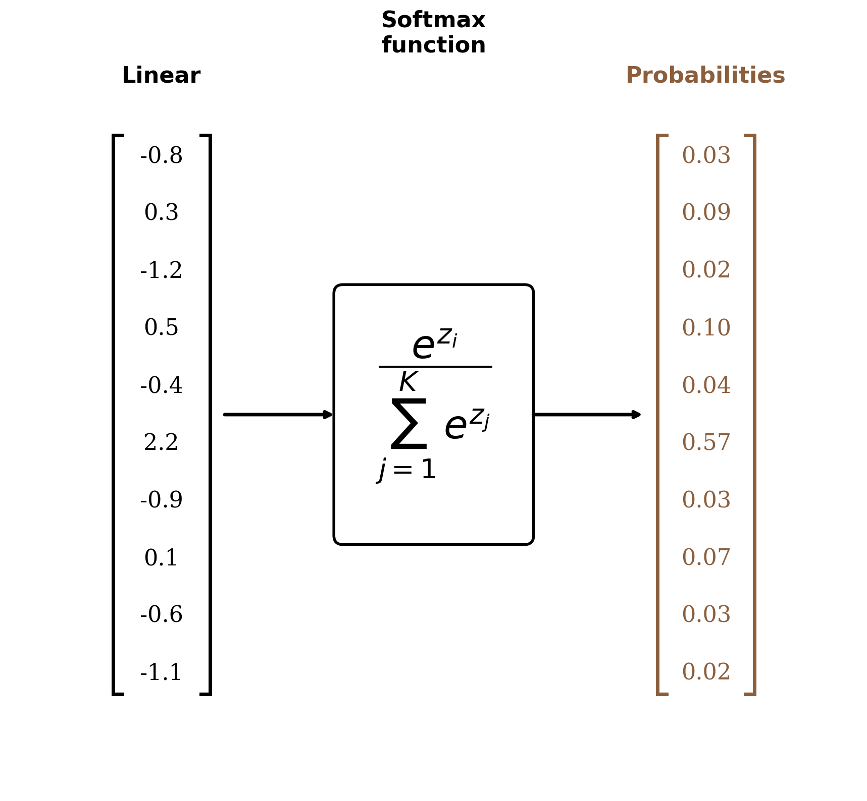
Softmax for Multi-Class Output

Slide 48
Stochastic Gradient Descent
Computing gradients on the full dataset is incredibly slow for large data (millions or billions) – weight updating becomes impossible
Stochastic gradient descent: divide data into batches (e.g., 32, 64) and do weight updates using the gradient only from the batch Each full pass through the training data is 1 epoch

Slide 49
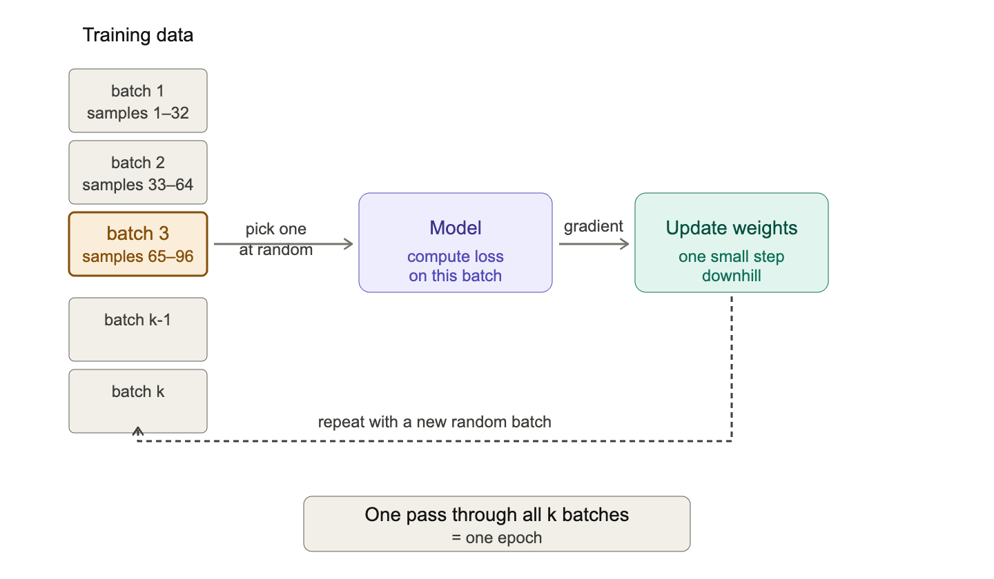
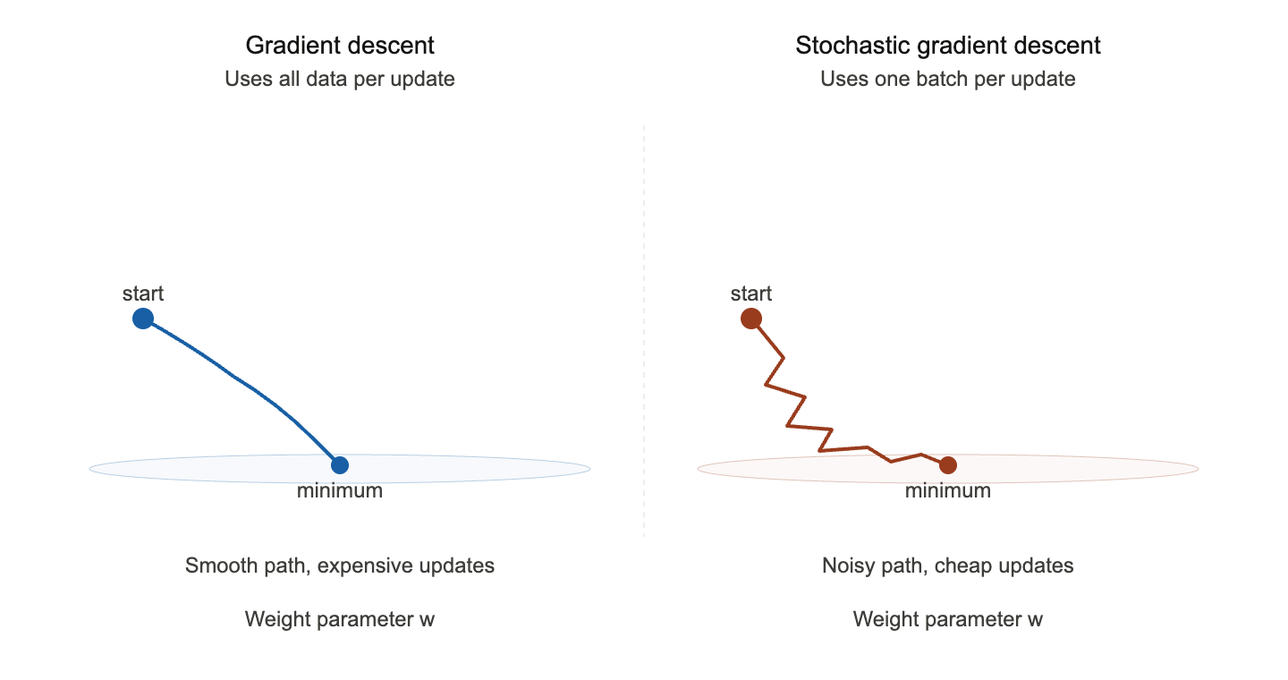
Stochastic Gradient Descent

Slide 50
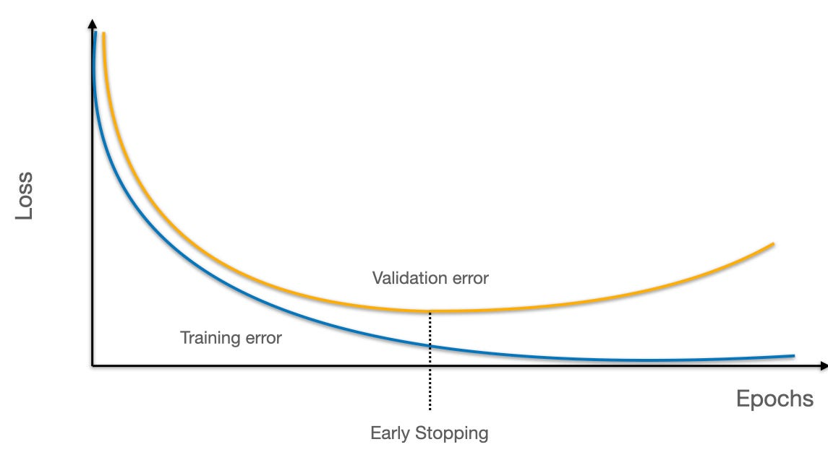
Preventing Overfitting
Deep neural networks can have millions of parameters, can be prone to overfitting in small datasets
Early stopping: Limit number of epochs
L2 regularization: add λ·∑w² to the loss to penalize large weights (same idea as Ridge)
Smaller network: limit number of weight parameters
Get more data: The best approach where possible
In practice, overfitting not a major concern anymore because of scale of datasets (entire internet)

Slide 51
Deploying Deep Learning Models

Slide 52
Computation and Hardware
What does training a neural network look like in practice?
A large number of multiplication/additions from backpropagation – that’s all
Each epoch = 6 * number of weights * number of data points

Slide 53
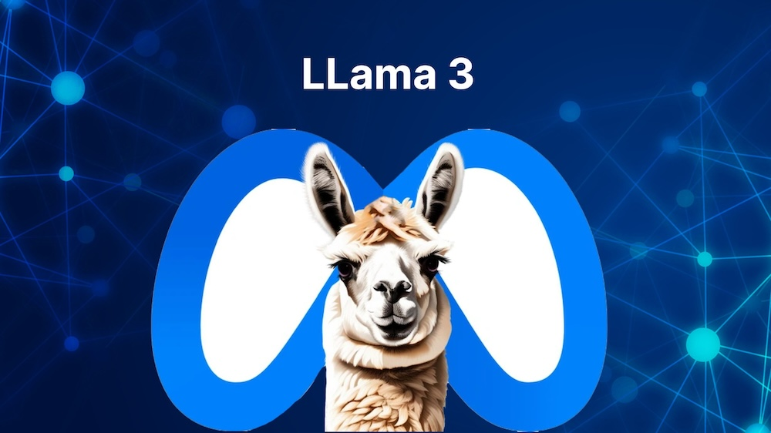
Example: Training A “Small” LLM
LLama 3 8B (released by Meta 2024):
8 billion parameters
15 trillion data points (i.e., words)
6*(8 billion)*(15 trillion) = 7.2 x 10²³ (720 sextillion) multiplication/additions

Slide 54

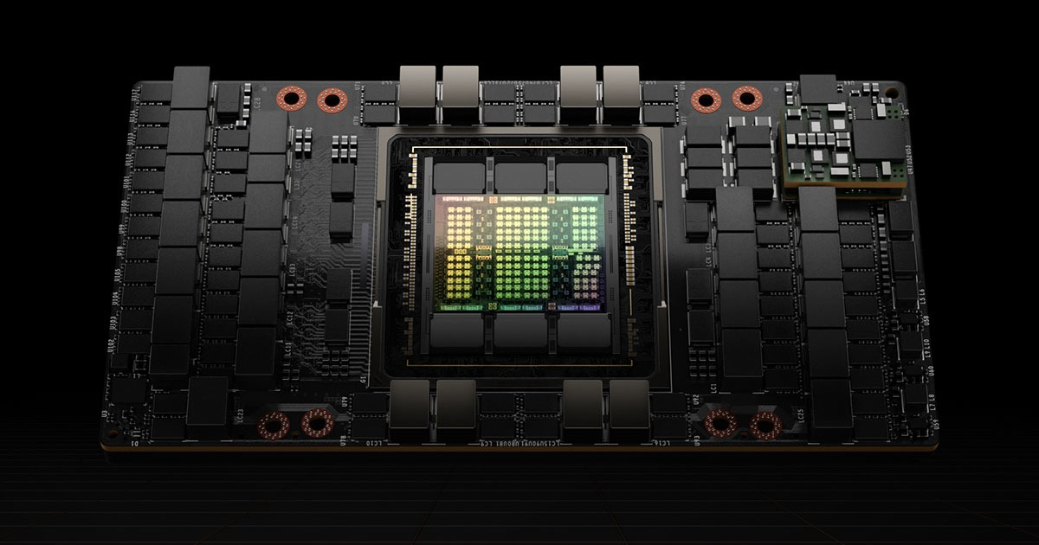
Computation and Hardware
Graphical Processor Units (GPUs): Initially for video games, rendering millions of pixels per second simultaneously Discovered to be the perfect hardware for training massive neural networks – rendering 3D images and backprop both require enormous number of simple multiplication/addition
Central Processing Units (CPUs) are much more sophisticated but limited in the number of simultaneous multiplications/additions they can do
“100 Swiss Army knives”
“100,000 hammers”
~100 trillion multiply-adds/sec
~4,000 trillion multiply-adds/sec
CPU (Intel Xeon 6)
GPU (NVIDIA H100)
Notes:
Llama 3 8B used 16,000 H100
30k a pop
500 million total

Slide 55
Deep Learning Packages
Three dominant Python packages for industry-strength deep learning models
PyTorch: Created by Meta (2016). Default for AI research and most frontier model training. Super flexible and allows fine-grained optimization and customization
TensorFlow: Created by Google (2015). Good for rapid prototyping, mobile apps. Useful Keras interface makes coding easy
JAX: Created by Google (2018). Google's newer framework for its own frontier models. Optimized for Google's TPU hardware.

Slide 56
Who uses what?
Year | Model | Framework | Cloud | Hardware
2016 | Google Translate | TensorFlow | Google Cloud | Google Tensor Processing Unit (TPU)
2019 | GPT-2 (OpenAI) | TensorFlow | Google Cloud | Google TPUs
2020–23 | GPT-3 / GPT-4 (OpenAI) | PyTorch | Microsoft Azure | NVIDIA A100 / H100 GPUs
2024– | Claude (Anthropic) | PyTorch, JAX | AWS, Google Cloud | Google TPUs, AWS Trainium, NVIDIA GPUs
2024– | LLaMA 3 & 4 (Meta) | PyTorch | Meta's own data centers | NVIDIA H100 GPUs
2024– | Gemini (Google DeepMind) | JAX | Google Cloud | Google TPUs
2022– | Stable Diffusion (Stability AI) | PyTorch | AWS | NVIDIA A100 GPUs

Slide 57


Slide 58
Assignment 4

Slide 59
Glossary (1/3)
Neural Network
A model made of layers of interconnected neurons that learns complex patterns by adjusting connection weights during training.
Neuron
The basic unit of a neural network: computes a weighted sum of inputs, adds a bias, and applies an activation function.
Activation Function
A nonlinear function applied after the weighted sum in a neuron, enabling the network to learn complex patterns. Common examples: ReLU, sigmoid.
Sigmoid
An activation function that squashes any value to a probability between 0 and 1, used for binary classification outputs.
ReLU
Rectified Linear Unit: an activation function that outputs zero for negative inputs and passes positive inputs through unchanged. The default choice for hidden layers.
Binary Cross-Entropy
A loss function for binary classification that measures how far predicted probabilities are from the true 0/1 labels.
Gradient Descent
An optimization algorithm that iteratively adjusts weights in the direction that reduces the loss, like walking downhill to find the lowest valley.

Slide 60
Glossary (2/3)
Learning Rate
A hyperparameter in gradient descent that controls the step size of each weight update; too high risks overshooting the minimum, too low makes training slow.
Backpropagation
The algorithm for computing how much each weight in the network contributed to the error, so gradient descent can update all weights efficiently.
Hidden Layer
A layer of neurons between the input and output layers that learns intermediate representations of the data.
Epoch
One complete pass through the entire training dataset. Models typically train for 10 to 100 epochs.
Softmax
An activation function for multi-class output that converts raw scores into probabilities summing to 1, one per class.
Early Stopping
Halting training when validation performance stops improving, to prevent overfitting.

Slide 61
Glossary (3/3)
Perceptron
Rosenblatt's 1958 single-layer neural network; a foundational model that could only handle simple problems.
Representation
The internal features a neural network learns from raw input data, replacing hand-engineered features used in traditional models.
Architecture
The specific configuration of layers, nodes, and connections that defines a neural network's structure and capacity.
Stochastic Gradient Descent (SGD)
A version of gradient descent that updates weights using small batches of data (e.g., 32 or 64 samples) at a time, making training feasible on massive datasets.

